Slide 1


WRITING TASK 2
SUBSCRIBE

Slide 2

www.studyabroadlife.org
WRITING TASK 2
For Writing Task 2 you are given 40 mins and a topic to write down an essay in minimum 250 words which should be extended to 280 words.
Task 2 counts more towards your Writing band score
  Task 1 = 1/3rd of your score
  Task 2 = 2/3rds of your score

Slide 3
www.studyabroadlife.org
TIME MANAGEMENT IN WRITING TASK 2
  Essay planning 5 minutes
  Writing 32 minutes
  Final Proof Reading 3 minutes

Slide 4
www.studyabroadlife.org
WHAT IS PARAPHRASING THESIS STATEMENT?
  Paraphrasing is the expression of a phrase or sentence in another way it should be in 2-3 lines .
  Helps you to focus on the main topic, using your own words
  Prevents redundancy and makes the sentence structure in the essay or written material more appealing to the reader.
  Thesis statement is a statement which gives an overview to the examiner what next student has written in detail in body paragraphs

Slide 5
www.studyabroadlife.org
COMMON ESSAY TOPICS
  Art
  Business & Money
  Communication & Personality
  Crime & Punishment
  Economics
  Education
  Environment
  Family & Children
  Food
  Health
  Media & Advertising
  Language

Slide 6
www.studyabroadlife.org
OTHER COMMON ESSAY TOPICS
  Reading
  Technology
  Transport
  Travel
  Society
  Sport
  Work
  And any 1 you get in the exam

Slide 7
www.studyabroadlife.org
GENERAL FORMAT OF ESSAY
  Paraphrase the question statement in 2-3 lines and then give your opinion which is a part of thesis statement in minimum 2 and max 3 lines
  Thesis statement is a statement which gives an overview to the examiner what next student has written in detail between 35-50 words
  Format of Body Para
  Min 2 max 3 para
  State the topic
  Explain the topic
  Support it with example
  Between 100-110 words for each para
Conclusion: Summarising your essay in min 2 and max 3 lines without adding any new points not mentioned in essay.

Slide 8
www.studyabroadlife.org
TYPES OF ESSAY
  To What extent you Agree / Disagree
  Positive or Negative Development
  Discuss both points of view and give your opinion
  Advantages Outweigh the Disadvantages and vice-versa
  Causes and Solutions/Advantages & Disadvantages/Problems and Solutions
  Double Questions
  Direct Opinion Essay

Slide 9
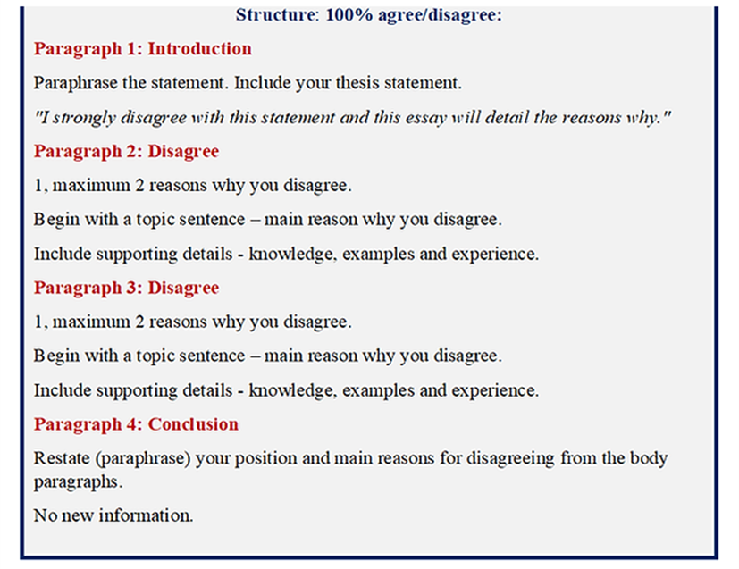
www.studyabroadlife.org
To What Extent Agree Disagree Essay

Slide 10
www.studyabroadlife.org
Agree/Disagree Essay 50% agree and 50% disagree
Introduction (approx. 40-50 words):
  Sentence 1: Paraphrase the prompt/topic.
  Sentence 2: Give a clear opinion (e.g., "While I agree with..., I also believe...”, I agree to some
  point or to some extent).
Body Paragraph 1 (approx. 80-100 words):
  Topic Sentence: First reason for your view.
  Explanation: Explain the point in detail.
  Example: Provide a concrete example to support your point.
Body Paragraph 2 (approx. 80-100 words):
  Topic Sentence: Second reason or opposing view/balanced perspective.
  Explanation/Example: Support this point.
Conclusion (approx. 30-40 words):
  Sentence 1: Summarize the main points and restate your opinion in different words

Slide 11
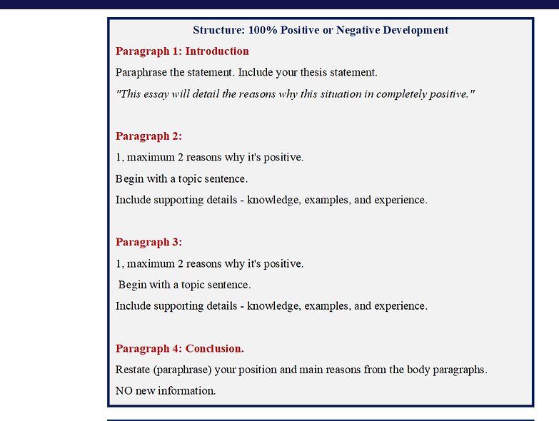
www.studyabroadlife.org
Positive OR Negative Development

Slide 12
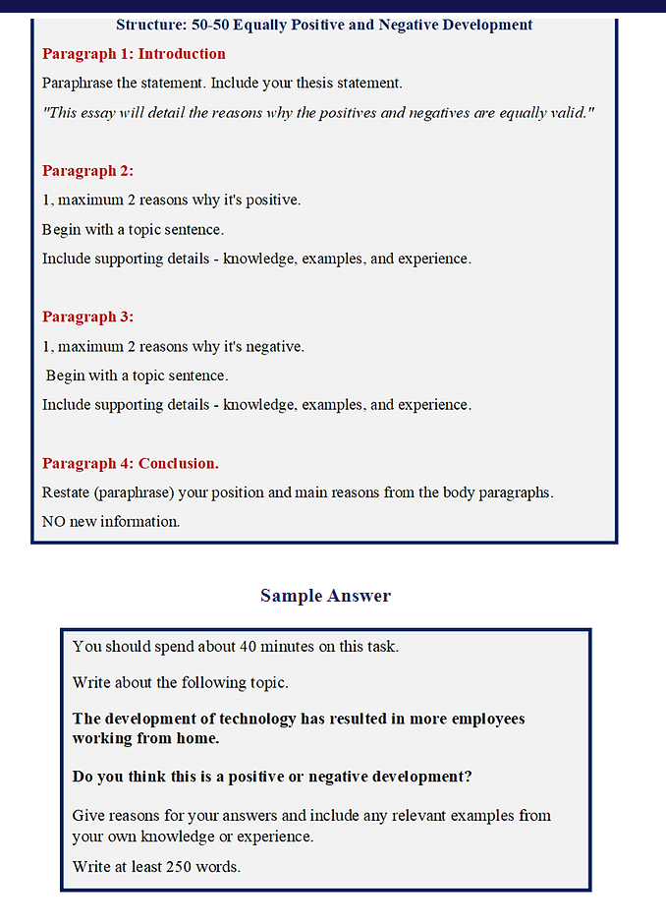
www.studyabroadlife.org

Slide 13
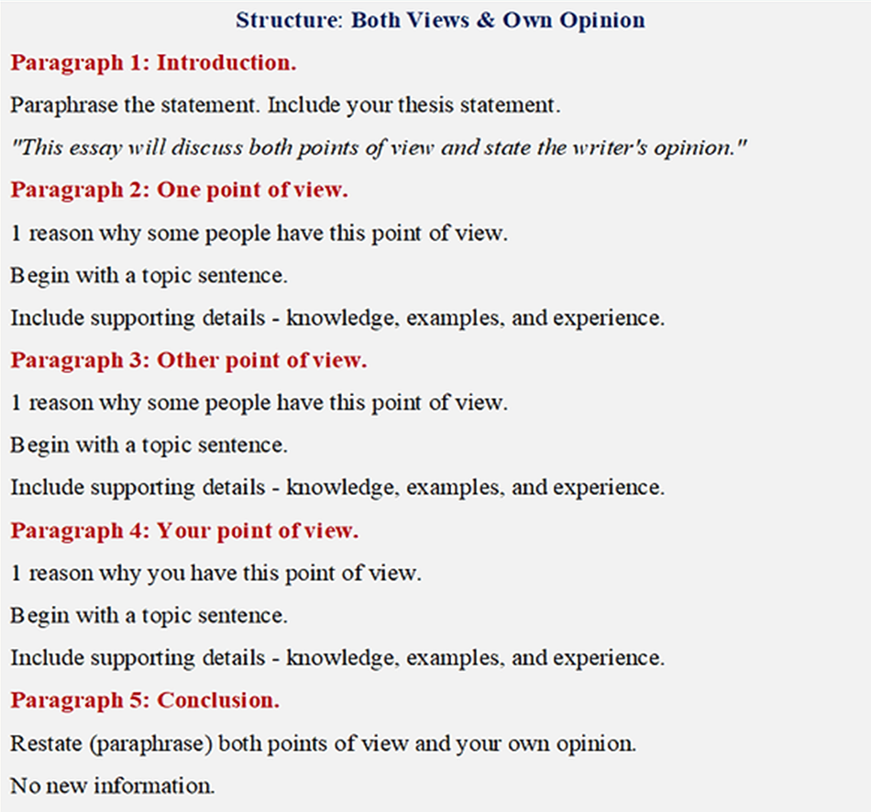
www.studyabroadlife.org
Discuss both points of view and give your own opinion

Slide 14
www.studyabroadlife.org
Advantages outweigh the disadvantages
Introduction (30-50 words)
Paraphrase the prompt, and clearly
state your opinion (e.g., "Although there are some drawbacks,
the benefits are more significant").
Body Paragraph 1 (Advantages): Discuss 2-3 benefits with
examples.
Body Paragraph 2 (Drawbacks): Discuss 1-2 drawbacks with
examples.
Conclusion (30-50 words): Summarize main points and
reiterate your opinion.

Slide 15
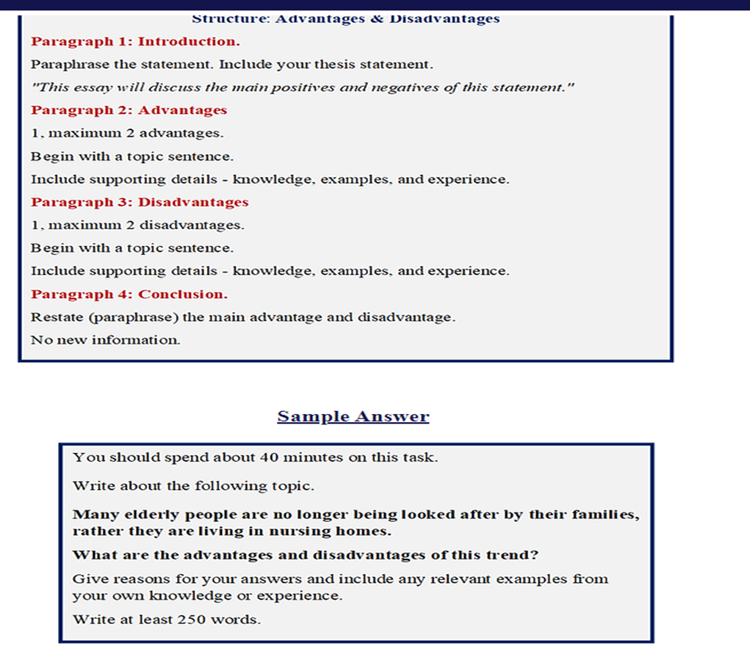
www.studyabroadlife.org
Advantages and disadvantages essay

Slide 16
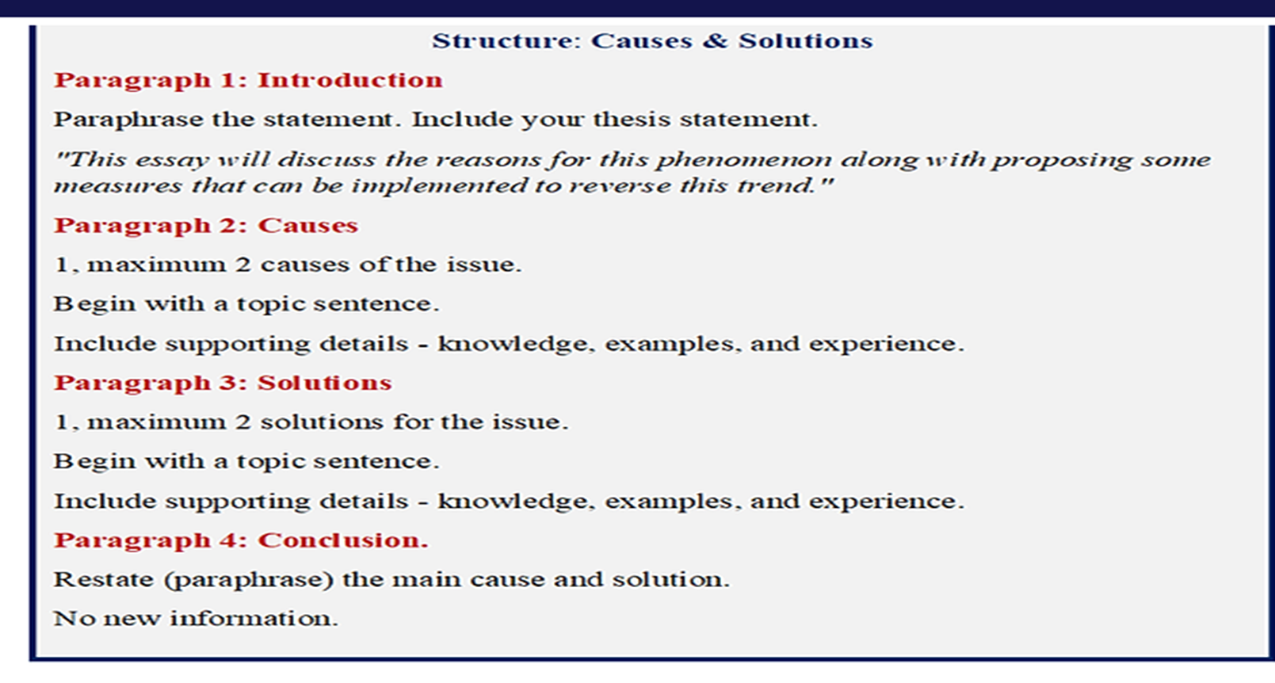
www.studyabroadlife.org
Causes and solutions

Slide 17
www.studyabroadlife.org
Double Question Essay
Introduction (paraphrase + answer both questions in short
Body Paragraph 1 (answer first question in detail with),
Body Paragraph 2 (answer second question in detail),
Conclusion (summarize both questions answers).
It tests your ability to address two distinct, related questions directly, usually requiring causes/solutions, reasons/opinions, problems/solutions.
Example: In education and employment, some people work harder than others. Why do some people work harder? Is it always a good thing to work hard?
Modern technology has changed how we communicate. How has it altered relationships? Is this positive or negative?

Slide 18
www.studyabroadlife.org
Direct Opinion Essay
Introduction (Paraphrase + Clear opinion),
Two Body Paragraphs (supporting arguments with examples)
Conclusion (summary + restated opinion).
You must take a clear, consistent stance throughout, supported by two main ideas, rather than discussing both sides equally.
Be Direct: Do not sit on the fence; take a firm position.
Stay Consistent: If you agree, do not argue against it in the body paragraphs.
Use Linking Words: Use cohesive devices (e.g., Furthermore, However, For instance, Therefore) to connect ideas.

Slide 19
www.studyabroadlife.org
Thank You

