Slide 1


SUBSCRIBE

Slide 2

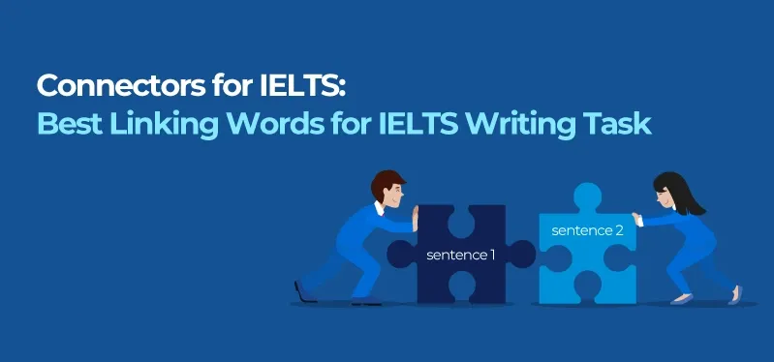
www.studyabroadlife.org
CONNECTORS TO BE USED FOR WRITING AND SPEAKING EXAM
  Connectors connects two sentences together to make it a complex sentence which weighs 25% in the writing exam.

Slide 3
www.studyabroadlife.org
CONNECTORS FOR THE WRITING AND SPEAKING EXAM
Likewise (can be used for both the writing and speaking tests)
In his budget the Minister of Finance increased spending on higher education, he likewise improved spending on social development.
In the same way (can be used for both the writing and speaking tests)
Religious doctrine is used to teach people right from wrong in the same way as fables were used to teach
simple human truths.
Similarly (can be used for both the writing and speaking tests)
Italian painters are renowned for their innovative works. The Greeks are similarly known for their philosophies.

Slide 4
www.studyabroadlife.org
CONNECTORS FOR OUTCOME AND RESULT
Therefore (ok for both)
Most governments believe in the importance of education. They are, therefore, willing to invest large amounts of money in improving the quality of the education.
As a consequence (ok for both)
The nuclear disaster at Fukushima was worse than the scientists had anticipated. As a consequence, the Japanese government has changed the way that nuclear power plants are built.
Thus (more for writing)
The local council received additional funding for the arts. They were, thus able to renovate the art gallery on the city centre.
As a result (neutral, can be used in the speaking and in your essays)
It rains quite often in Europe, as a result, most Europeans tend to vacation in sunnier destinations.

Slide 5
www.studyabroadlife.org
CONTRAST
In contrast
Coastal tourism is on the rise. In contrast, visits to urban areas are declining as people reduce business travel and confine meetings to video conferencing.
However
The government planned to re-introduce the death penalty. There was, however, a public outcry and they had to halt the legislation.
On the Contrary
Today most people are aware of the dangers of smoking, on the contrary, they still continue to damage their health by smoking.
Whereas
Laughing is a good medicine, whereas continuous laughing for long time can make people think that you may be behaving weird.
One the one hand, On the other hand (more used in writing ( for discussion essay) but can be used when speaking too)
On the one hand, Some people contend that antibacterial soaps and detergents are good because they ensure a bacteria free environment. On the other hand, there are those who disagree arguing that riding the environment of microbes robs us of the ability to form an immune response.

Slide 6
www.studyabroadlife.org
CONNECTORS TO ILLUSTRATE A SEQUENCE (WRITING)
First, Firstly, To begin with, To commence
Firstly, The local council should not allow people to sleep on the streets. Additionally, they should make sure they they are sheltered properly.
Second, Secondly,
It is first and foremost the government’s responsibility create employment. Secondly, they should ensure
that employers treat their workers fairly and with respect.
Thirdly, Finally, Lastly
In seeking employment, she wanted to ensure that she followed her dreams. Secondly, she wanted a decent wage and thirdly she hoped that there were opportunities for promotion.

Slide 7
www.studyabroadlife.org
CONNECTORS TO ADD MORE INFORMATION
In addition or Additionally
The organization offered to make amends for any problems that had been caused by the misinformation that had been published in their magazine. In addition, they discounted the next edition of the glossy publication.
Moreover
Over the years, computers have become more and more powerful, moreover they have also become less expensive.
Furthermore
The houses in the neighbourhood were large and spacious. Furthermore, they had easy access to public transport.

Slide 8
www.studyabroadlife.org
ORDER OF RELEVANCE OR IMPORTANCE
Most importantly
We should discuss how to maintain a work life balance, most importantly, how organisations can ensure that
employees are not overworked.
Most significantly
The president said that the year ahead would be different. Most significantly he indicated that he would re
allocate funding to obtaining additional resources.
Essentially,
The manager said that it was essentially the responsibility of every employee to ensure that the customers were
delighted with the service that they received.
Most specifically
Eating vegetables is very good for eyesight, most specifically, carrots are thought to improve your night vision.

Slide 9
www.studyabroadlife.org
EXEMPLIFICATION – GIVING EXAMPLES
1 For example (suitable for both)
If, for example, we could put the well-being of others before ourselves, the world would be a much happier place for all.
2 For instance (suitable for both)
Modern urban populations are battling lifestyle diseases brought on by obesity. Diabetes, for instance, is growing in prevalence and more and more people have to take chronic medication.
3 To illustrate
Misinformation can cause many disagreements. To illustrate, a company advertising goods at an incorrect price could lead to disgruntled customers.

Slide 10
www.studyabroadlife.org
SUMMARIZING OR CONCLUDING
In summary
In summary, I have come to the realization that communication plays a big role in the success of a team.
To sum up
To sum up my thoughts, I think choosing a single piece of art from a couple hundred is rather difficult.
In conclusion
In conclusion, winning isn’t necessarily the most important thing, it’s the way you played the game.
To sum up
The project turned out okay, to sum up, I think everyone did a fantastic job.

Slide 11
www.studyabroadlife.org
FOCUSING AND LINKING ( TASK 1 )
With respect to
With respect to the contract, we regret that we are unable to accept the terms and conditions.
Regarding
Regarding the proposal, we regret that we are unable to agree with some of your requirements.
With regards to
With regards to energy production by solar, Canada excelled into it with 90 percent of energy comprised of solar.
Talking of / speaking of (speaking )
Talking of relocating, do you know where you going to stay? Have you found and apartment?

